Slide 1

Internet of Things Application

Slide 2
Meet Our Team
Ahmed Abdelhamed
Backend Developer
Ashraf Mohy
Frontend Developer
Hady elHady
Mohamed Ahmed
UI Designer
Waleed Ziad
Backend Developer
Embedded Developer

Slide 3

© Copyright Intel corporation

Slide 4
What
is
Internet
of
Things
?

Slide 5
Problem Definition
Lack of IOT Apps
Lack of developers, Different Discipline.
Difficulty to scale and Secure a big no. of conn.
Low resources of embedded Devices

Slide 6


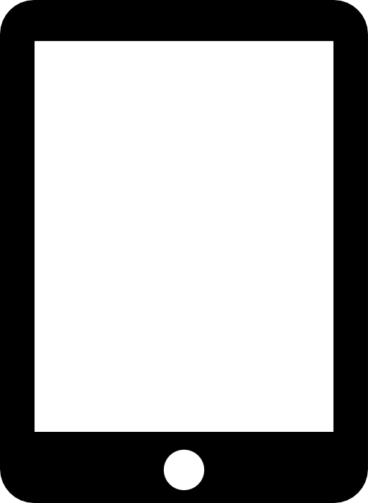

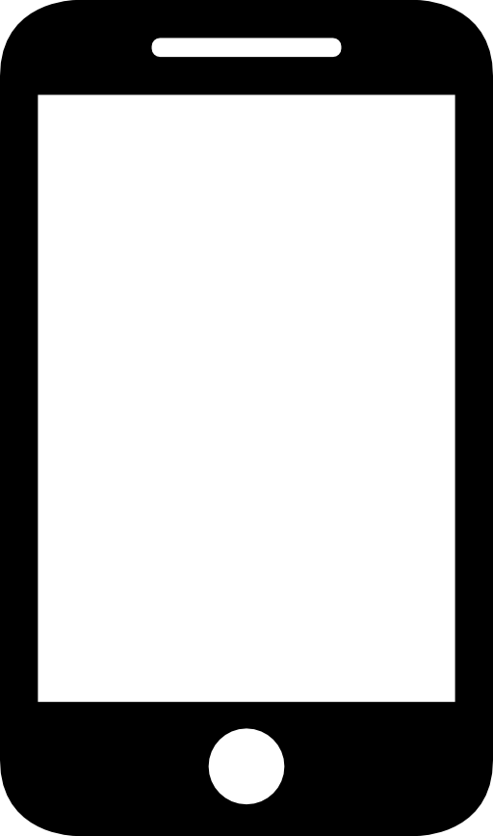


Solution Summary
Build a platform that will abstract a lot for him and let him focus on the functionality of his project without worrying about scalability, security and reliability.

Slide 7
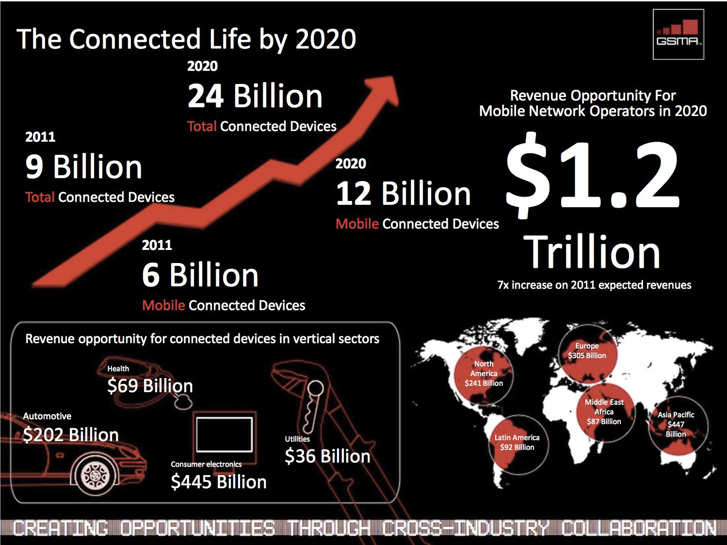
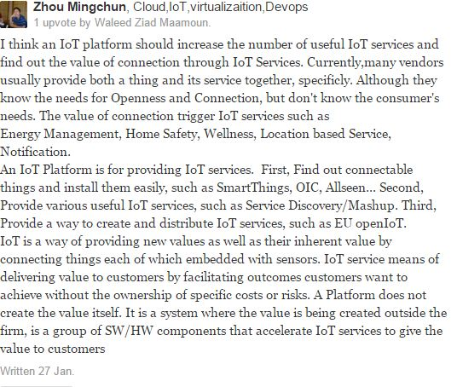
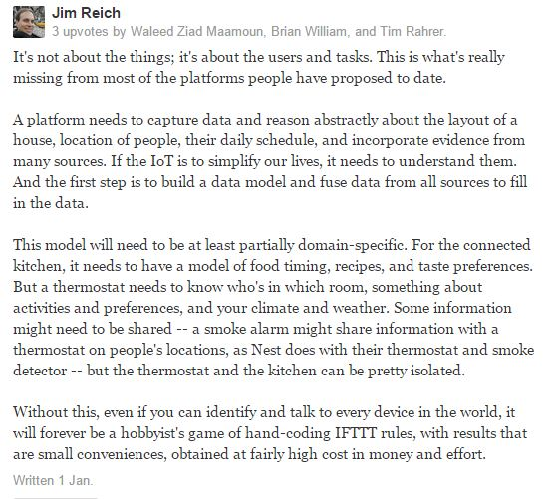
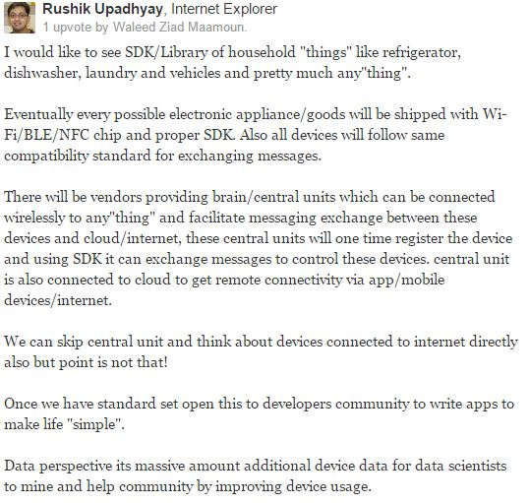
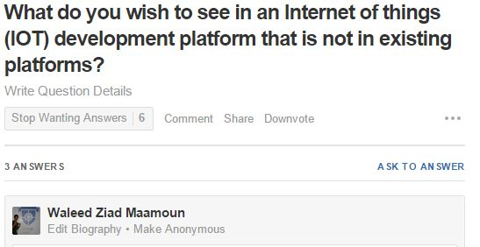
Feasibility Study
Answer no.1:
Answer no.3:
Answer no.2:
Question:
Rushik Upadhyay
PayPal
Zhou Mingchun
IOT Expert at Samsung Electronics
Jim Reich
Researcher at Carnegie Mellon University

Slide 8
Hardware
Platform

Slide 9


Analysis
Existing Products

Slide 10
Features
Ability to visualize these data
Receives and save data feed from embedded device
Provide data analytics for these data
Real time communication between device and server using MQTT protocol
Providing REST API for other application to be able to reuse data
Ability to write code that would be executed with coordination of the embedded device
Ability to deploy code remotely on the embedded device " over the Air " deployment
Ability to push notifications from server to device

Slide 11
Deliverables
Server
Side
Web Ide that will allow the user to
write code to interact with data
coming form embedded device
Embedded Library
Implementation of the MQTT
protocol on the embedded device
Dashboard for the user to control
his data flow , add devices ,
retrieve data , etc
Handle over the Air
redeployment of code
API to allow use another data from other websites

Slide 12
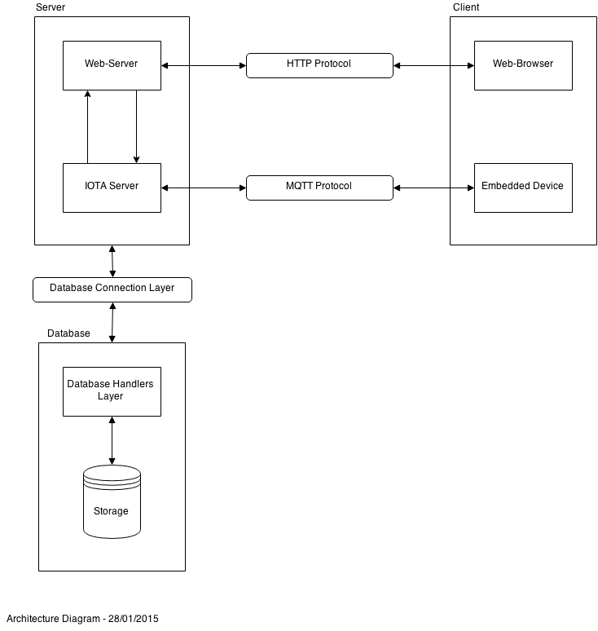
Architectural Design

Slide 13
Java EE
Spring MVC
Hibernate
HTML
CSS
Mosquitto
Technologies Used
JPA
Java Script
Eclipse Paho
Raspberry Pi
Embedded Linux
Dream Weaver

Slide 14
Left
Some Integration
End to end testing
What’s

Slide 15
Timeline
Feasibility and Research
Requirements Gathering
Preliminary Design
MQTT (Server Side) and Data Analysis
MQTT Embedded Library and Web Database Backend Interface + IDE(1)
UI Design and Skills Developing
Data Visualization
And unit testing
Over The Air in Embedded Library and Web Backend (1) + IDE (2)

Slide 16
Demo

Slide 17
Summary

Slide 18
Any Questions ?

Slide 19
Thank You

